Slide 1
Data Mining Cluster Analysis: Advanced Concepts and Algorithms
Lecture Notes for Chapter 9
Introduction to Data Mining
by
Tan, Steinbach, Kumar

Slide 2
Hierarchical Clustering: Revisited
Creates nested clusters
Agglomerative clustering algorithms vary in terms of how the proximity of two clusters are computed
MIN (single link): susceptible to noise/outliers
MAX/GROUP AVERAGE: may not work well with non-globular clusters
CURE algorithm tries to handle both problems
Often starts with a proximity matrix
A type of graph-based algorithm

Slide 3
CURE: Another Hierarchical Approach
Uses a number of points to represent a cluster
Representative points are found by selecting a constant number of points from a cluster and then “shrinking” them toward the center of the cluster
Cluster similarity is the similarity of the closest pair of representative points from different clusters
×
×

Slide 4
CURE
Shrinking representative points toward the center helps avoid problems with noise and outliers
CURE is better able to handle clusters of arbitrary shapes and sizes

Slide 5
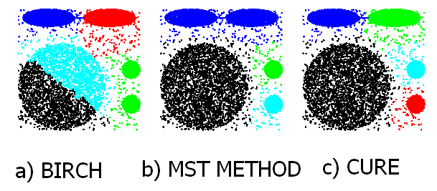
Experimental Results: CURE
Picture from CURE, Guha, Rastogi, Shim.

Slide 6
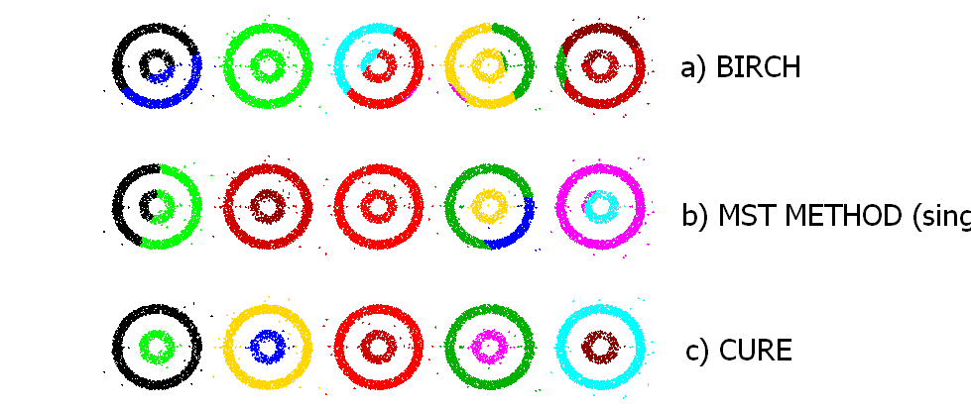
Experimental Results: CURE
(centroid)
(single link)
Picture from CURE, Guha, Rastogi, Shim.

Slide 7
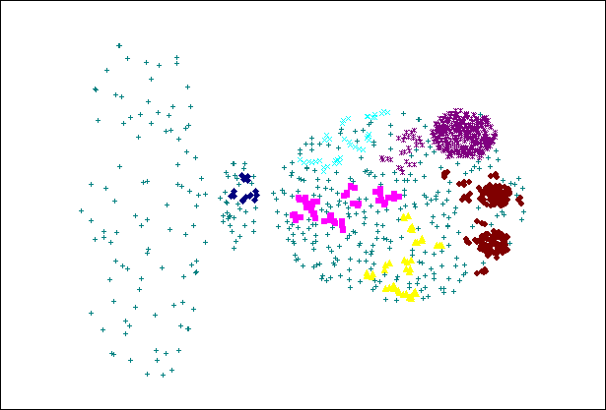
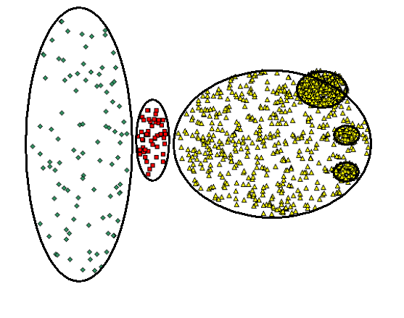
CURE Cannot Handle Differing Densities
Original Points
CURE

Slide 8
Graph-Based Clustering
Graph-Based clustering uses the proximity graph
Start with the proximity matrix
Consider each point as a node in a graph
Each edge between two nodes has a weight which is the proximity between the two points
Initially the proximity graph is fully connected
MIN (single-link) and MAX (complete-link) can be viewed as starting with this graph
In the simplest case, clusters are connected components in the graph.

Slide 9
Graph-Based Clustering: Sparsification
The amount of data that needs to be processed is drastically reduced
Sparsification can eliminate more than 99% of the entries in a proximity matrix
The amount of time required to cluster the data is drastically reduced
The size of the problems that can be handled is increased

Slide 10
Graph-Based Clustering: Sparsification …
Clustering may work better
Sparsification techniques keep the connections to the most similar (nearest) neighbors of a point while breaking the connections to less similar points.
The nearest neighbors of a point tend to belong to the same class as the point itself.
This reduces the impact of noise and outliers and sharpens the distinction between clusters.
Sparsification facilitates the use of graph partitioning algorithms (or algorithms based on graph partitioning algorithms.
Chameleon and Hypergraph-based Clustering

Slide 11
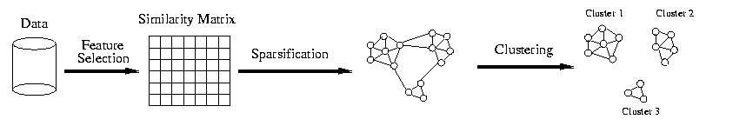
Sparsification in the Clustering Process

Slide 12
Limitations of Current Merging Schemes
Existing merging schemes in hierarchical clustering algorithms are static in nature
MIN or CURE:
merge two clusters based on their closeness (or minimum distance)
GROUP-AVERAGE:
merge two clusters based on their average connectivity

Slide 13
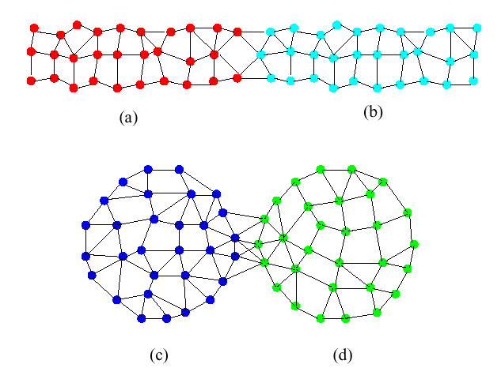
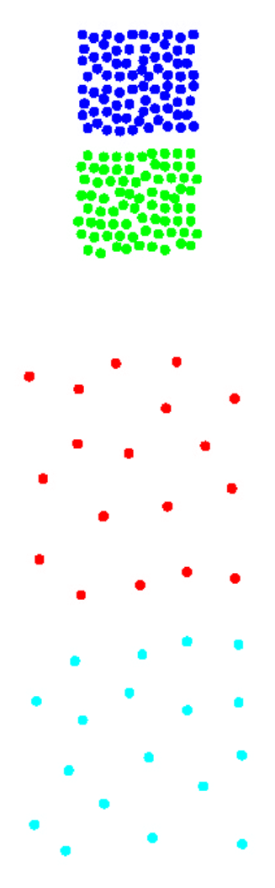
Limitations of Current Merging Schemes
(a)
(b)
(c)
(d)
Closeness schemes will merge (a) and (b)
Average connectivity schemes will merge (c) and (d)

Slide 14
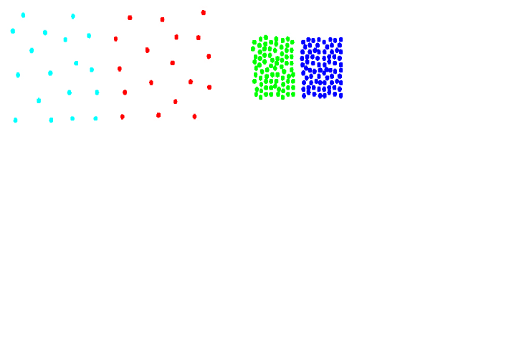
Chameleon: Clustering Using Dynamic Modeling
Adapt to the characteristics of the data set to find the natural clusters
Use a dynamic model to measure the similarity between clusters
Main property is the relative closeness and relative inter-connectivity of the cluster
Two clusters are combined if the resulting cluster shares certain properties with the constituent clusters
The merging scheme preserves self-similarity
One of the areas of application is spatial data

Slide 15
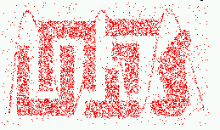
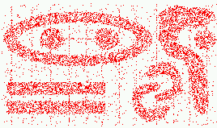
Characteristics of Spatial Data Sets
Clusters are defined as densely populated regions of the space
Clusters have arbitrary shapes, orientation, and non-uniform sizes
Difference in densities across clusters and variation in density within clusters
Existence of special artifacts (streaks) and noise
The clustering algorithm must address the above characteristics and also require minimal supervision.

Slide 16
Chameleon: Steps
Preprocessing Step: Represent the Data by a Graph
Given a set of points, construct the k-nearest-neighbor (k-NN) graph to capture the relationship between a point and its k nearest neighbors
Concept of neighborhood is captured dynamically (even if region is sparse)
Phase 1: Use a multilevel graph partitioning algorithm on the graph to find a large number of clusters of well-connected vertices
Each cluster should contain mostly points from one “true” cluster, i.e., is a sub-cluster of a “real” cluster

Slide 17
Chameleon: Steps …
Phase 2: Use Hierarchical Agglomerative Clustering to merge sub-clusters
Two clusters are combined if the resulting cluster shares certain properties with the constituent clusters
Two key properties used to model cluster similarity:
Relative Interconnectivity: Absolute interconnectivity of two clusters normalized by the internal connectivity of the clusters
Relative Closeness: Absolute closeness of two clusters normalized by the internal closeness of the clusters

Slide 18
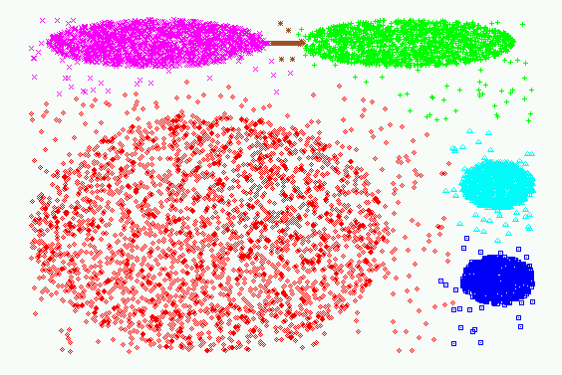
Experimental Results: CHAMELEON

Slide 19
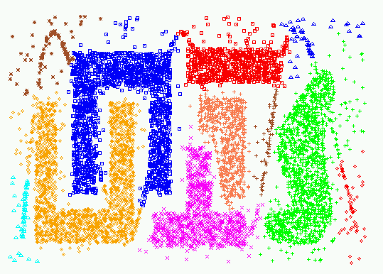
Experimental Results: CHAMELEON

Slide 20
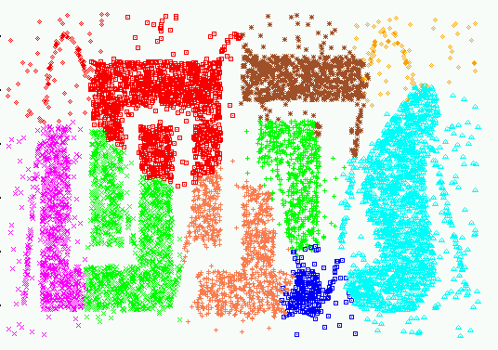
Experimental Results: CURE (10 clusters)

Slide 21
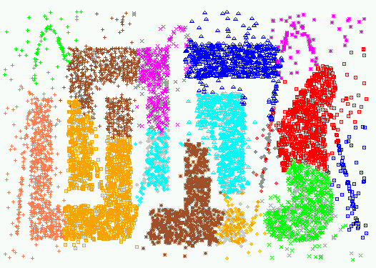
Experimental Results: CURE (15 clusters)

Slide 22
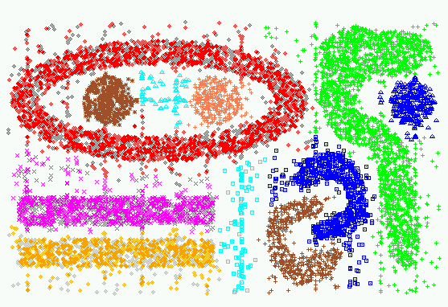
Experimental Results: CHAMELEON

Slide 23
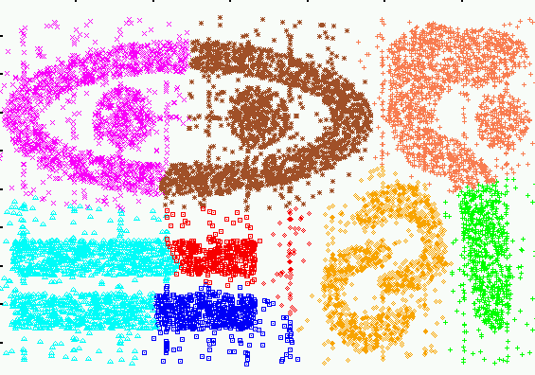
Experimental Results: CURE (9 clusters)

Slide 24
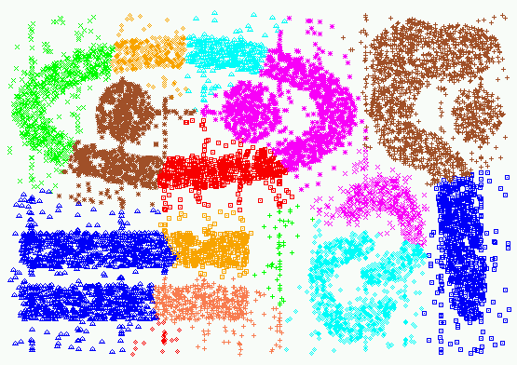
Experimental Results: CURE (15 clusters)

Slide 25
Shared Near Neighbor Approach
SNN graph: the weight of an edge is the number of shared neighbors between vertices given that the vertices are connected
i
j
i
j
4

Slide 26
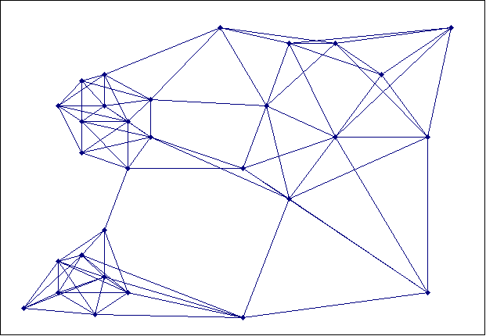
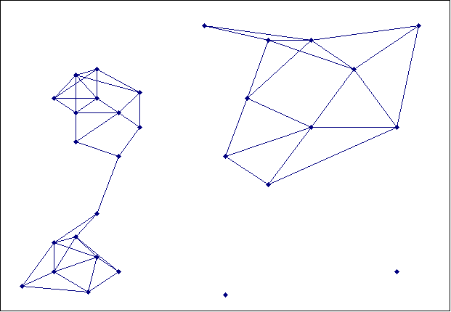
Creating the SNN Graph
Sparse Graph
Link weights are similarities between neighboring points
Shared Near Neighbor Graph
Link weights are number of Shared Nearest Neighbors

Slide 27
ROCK (RObust Clustering using linKs)
Clustering algorithm for data with categorical and Boolean attributes
A pair of points is defined to be neighbors if their similarity is greater than some threshold
Use a hierarchical clustering scheme to cluster the data.
Obtain a sample of points from the data set
Compute the link value for each set of points, i.e., transform the original similarities (computed by Jaccard coefficient) into similarities that reflect the number of shared neighbors between points
Perform an agglomerative hierarchical clustering on the data using the “number of shared neighbors” as similarity measure and maximizing “the shared neighbors” objective function
Assign the remaining points to the clusters that have been found

Slide 28
Jarvis-Patrick Clustering
First, the k-nearest neighbors of all points are found
In graph terms this can be regarded as breaking all but the k strongest links from a point to other points in the proximity graph
A pair of points is put in the same cluster if
any two points share more than T neighbors and
the two points are in each others k nearest neighbor list
For instance, we might choose a nearest neighbor list of size 20 and put points in the same cluster if they share more than 10 near neighbors
Jarvis-Patrick clustering is too brittle

Slide 29
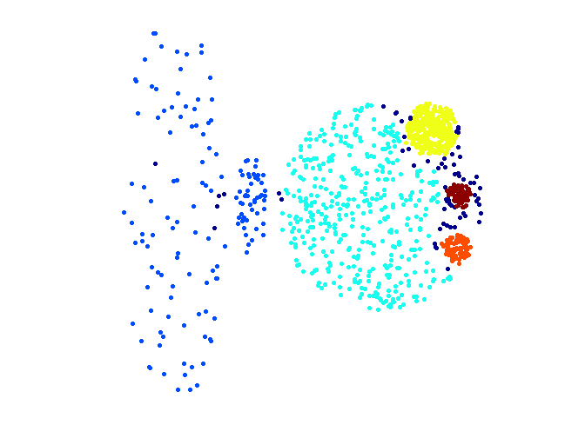
When Jarvis-Patrick Works Reasonably Well
Original Points
Jarvis Patrick Clustering
6 shared neighbors out of 20

Slide 30
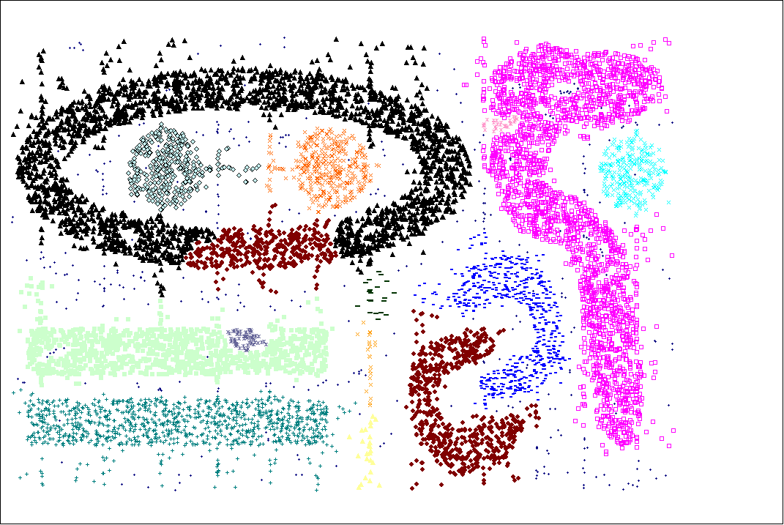
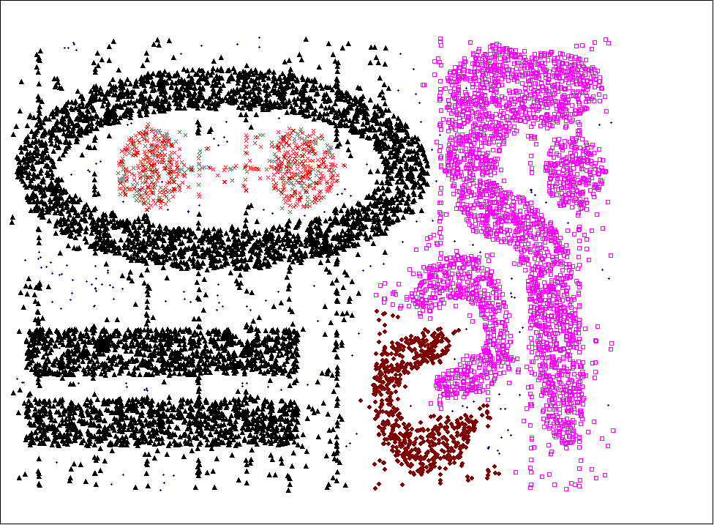
When Jarvis-Patrick Does NOT Work Well
Smallest threshold, T, that does not merge clusters.
Threshold of T - 1

Slide 31
SNN Clustering Algorithm
Compute the similarity matrix This corresponds to a similarity graph with data points for nodes and edges whose weights are the similarities between data points
Sparsify the similarity matrix by keeping only the k most similar neighbors This corresponds to only keeping the k strongest links of the similarity graph
Construct the shared nearest neighbor graph from the sparsified similarity matrix. At this point, we could apply a similarity threshold and find the connected components to obtain the clusters (Jarvis-Patrick algorithm)
Find the SNN density of each Point. Using a user specified parameters, Eps, find the number points that have an SNN similarity of Eps or greater to each point. This is the SNN density of the point

Slide 32
SNN Clustering Algorithm …
Find the core points Using a user specified parameter, MinPts, find the core points, i.e., all points that have an SNN density greater than MinPts
Form clusters from the core points If two core points are within a radius, Eps, of each other they are place in the same cluster
Discard all noise points All non-core points that are not within a radius of Eps of a core point are discarded
Assign all non-noise, non-core points to clusters This can be done by assigning such points to the nearest core point
(Note that steps 4-8 are DBSCAN)

Slide 33
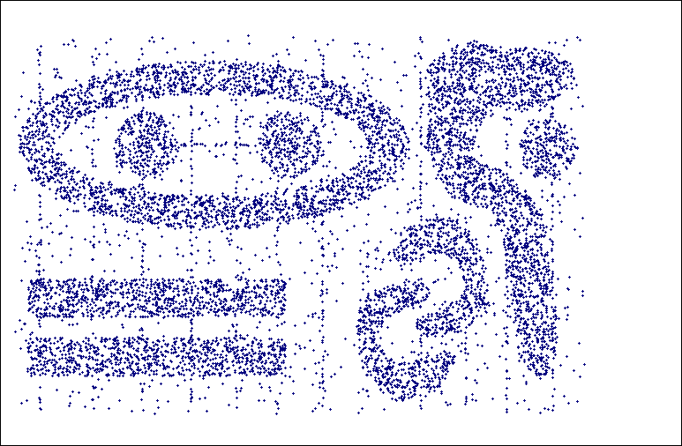
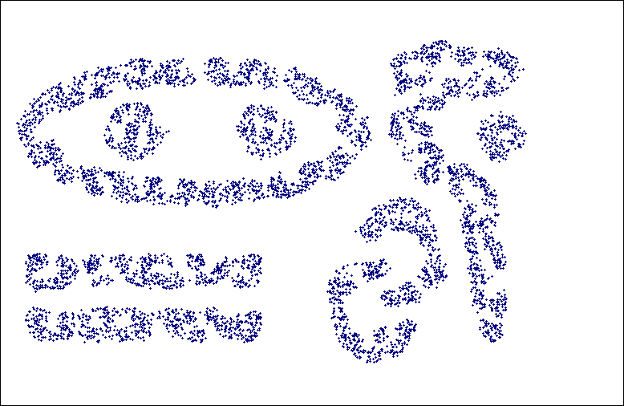
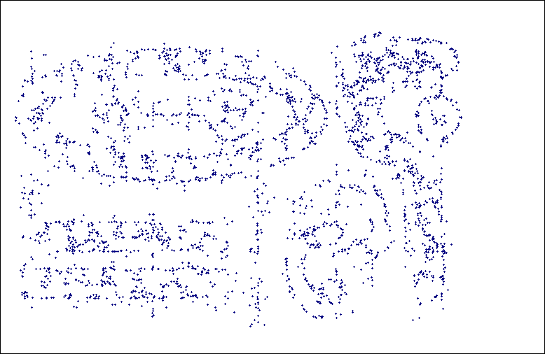
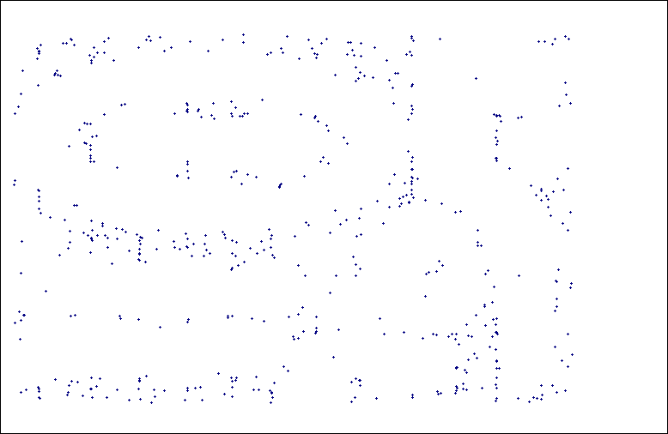
SNN Density
a) All Points b) High SNN Density
c) Medium SNN Density d) Low SNN Density

Slide 34
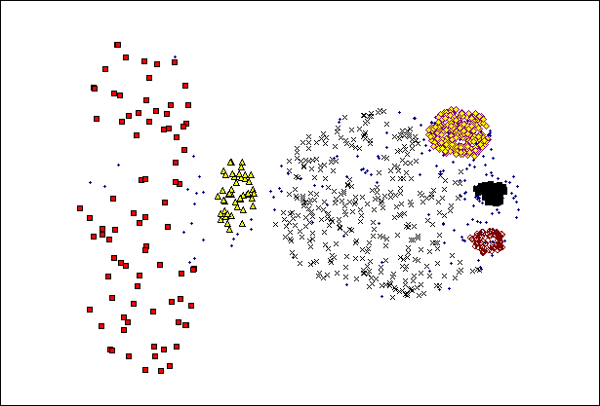
SNN Clustering Can Handle Differing Densities
Original Points
SNN Clustering

Slide 35
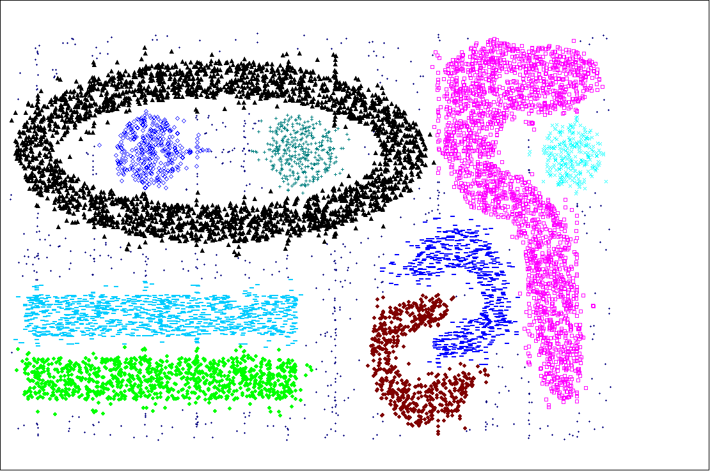
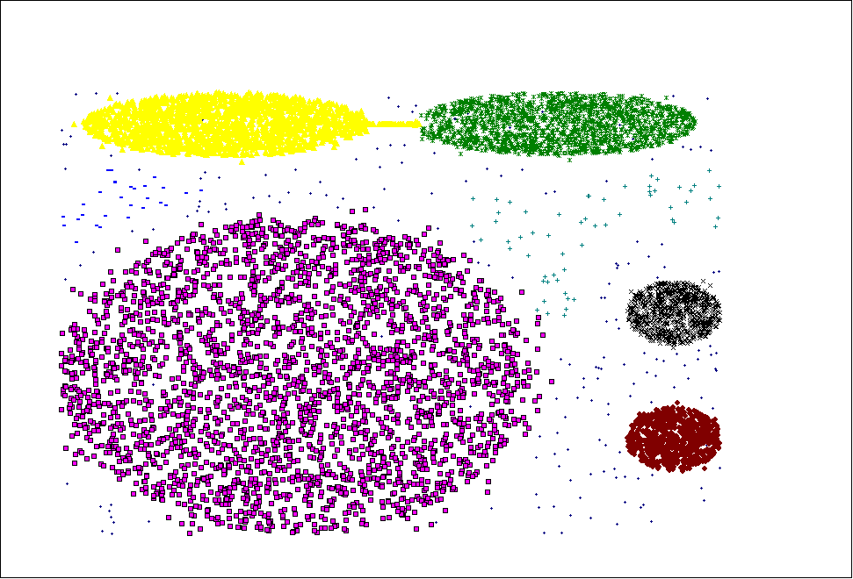
SNN Clustering Can Handle Other Difficult Situations

Slide 36
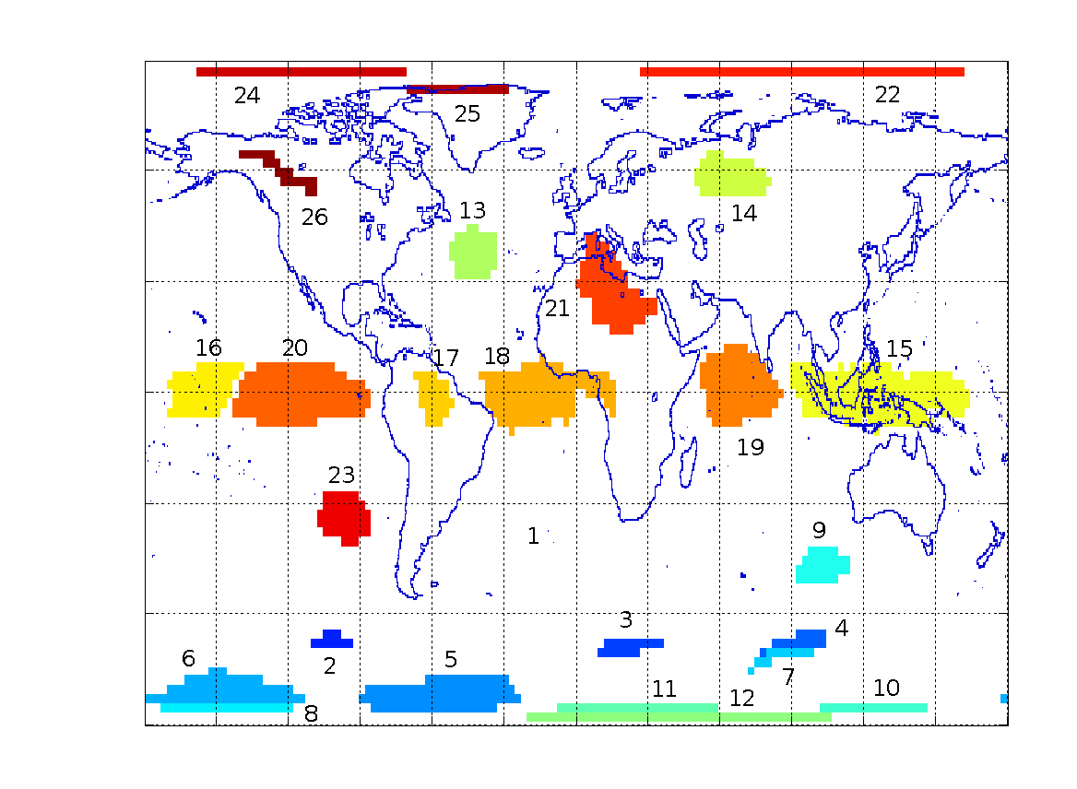
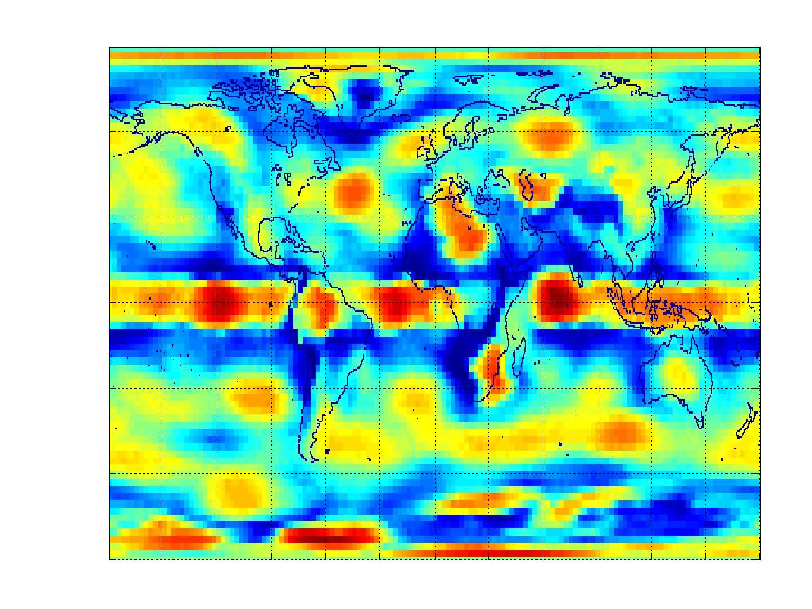
Finding Clusters of Time Series In Spatio-Temporal Data
SNN Clusters of SLP.
SNN Density of Points on the Globe.

Slide 37
Features and Limitations of SNN Clustering
Does not cluster all the points
Complexity of SNN Clustering is high
O( n * time to find numbers of neighbor within Eps)
In worst case, this is O(n²)
For lower dimensions, there are more efficient ways to find the nearest neighbors
R* Tree
k-d Trees

